Slide 1
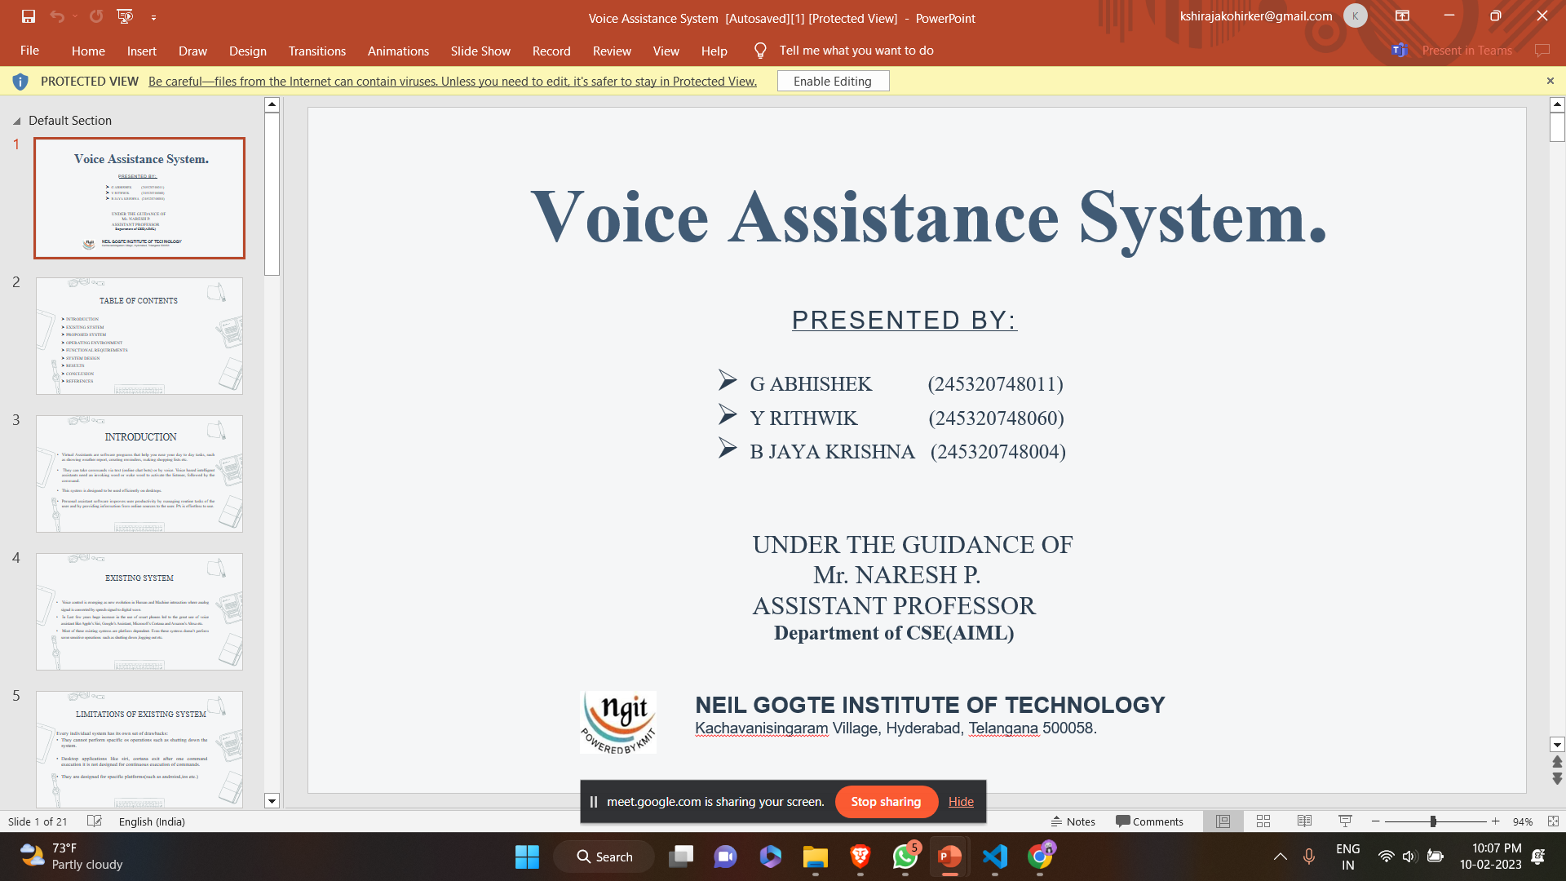

AI-CHATBOT SYSTEM
Presented by:
S.NIDHI SHREE 245320748043
UNDER GUIDANCE OF
Mr. K. SRINIVAS
ASSISTANT PROFESSOR
DEPARTMENT OF CSE(AIML)

Slide 2
GOOD MORNING RESPECTED SIRS AND MAAMS!
HELLO DEAR FELLOW MATES!

Slide 3
TABLE OF CONTENTS:
INTRODUCTION
EXISTING SYSTEM
PROPOSED SYSTEM
OPERATING ENVIRONMENT
FUNCTIONAL REQUIREMENTS
SYSTEM DESIGN
RESULT
CONCLUSION
REFERENCES

Slide 4
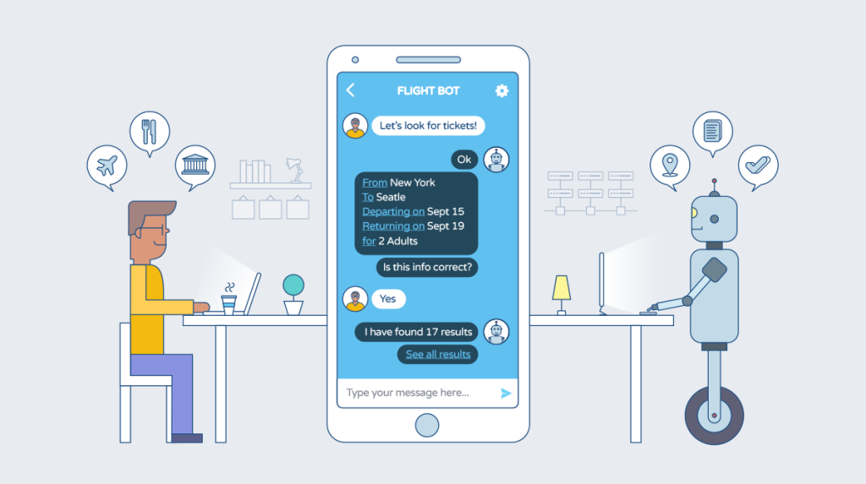
INTRODUCTION:
Instead of spreading the chatbot too thin over multiple functions, it can be crafted to focus entirely on one essential command.

Slide 5
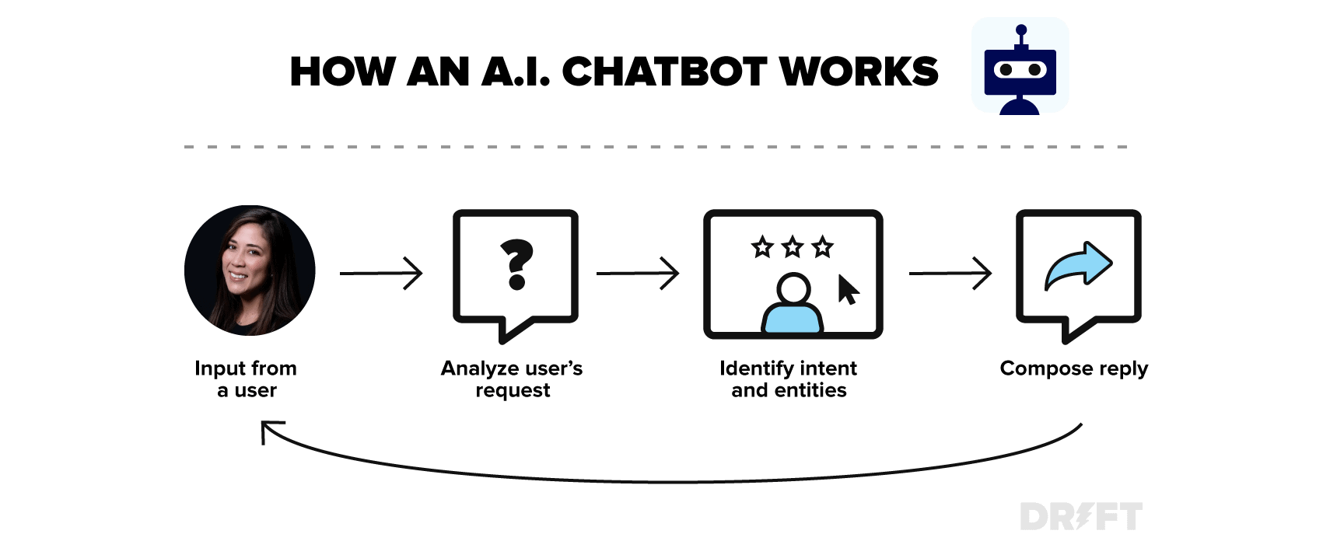
As students are facing problems after their 12th grade regarding the selection of Engineering college, as we were part of that we want to make it easy for those students to decide on their college according to their merits.
This help in reducing browsing time.

Slide 6
EXISTING SYSTEM:
While browsing, we found a few websites that focused only on that particular college.
Students need to manually visit the college to get their queries answered by the college help desk.
This process consumes a lot of time as well as money as the customer needed to visit college if it’s miles away from home.
Also, this process may lead to a communication gap between students and colleges.

Slide 7
PROPOSED SYSTEM:
This System is a web application that answers the student’s query.
Students just have to query through the bot which is used for chatting.
The System uses built-in artificial intelligence to answer the query. The answers are appropriate to what the user queries.
The system replies using an effective.
The graphical user interface implies that as if a real person is talking to the user The user does not have to personally go to the college for inquiry.
The System analyzes the question and then answers to the user.

Slide 8
OPERATING ENVIRONMENT:
Software Requirements:
Operating System : Windows 7 (Min)
Front End : HTML, CSS, JAVASCRIPT
Back End : FLASK, PYTHON
Database : JSON file
Hardware Requirements:
Processor : Intel Pentium® Dual Core Processor (Min)
Speed : 2.9 GHz (Min)
RAM : 2 GB (Min)
Hard Disk : 2 GB (Min)

Slide 9
FUNCTIONAL REQUIREMENTS:
Functional Requirements of Admin:
Admin plays a major role in this project.
Admin has the authority to manipulate the data in the database.
Adding college information daily
Updating the results and materials.
Functional Requirements of User:
The user will be able to ask queries regarding the colleges he/she wants to know.
The user will be answered to his/her queries within no time.

Slide 10
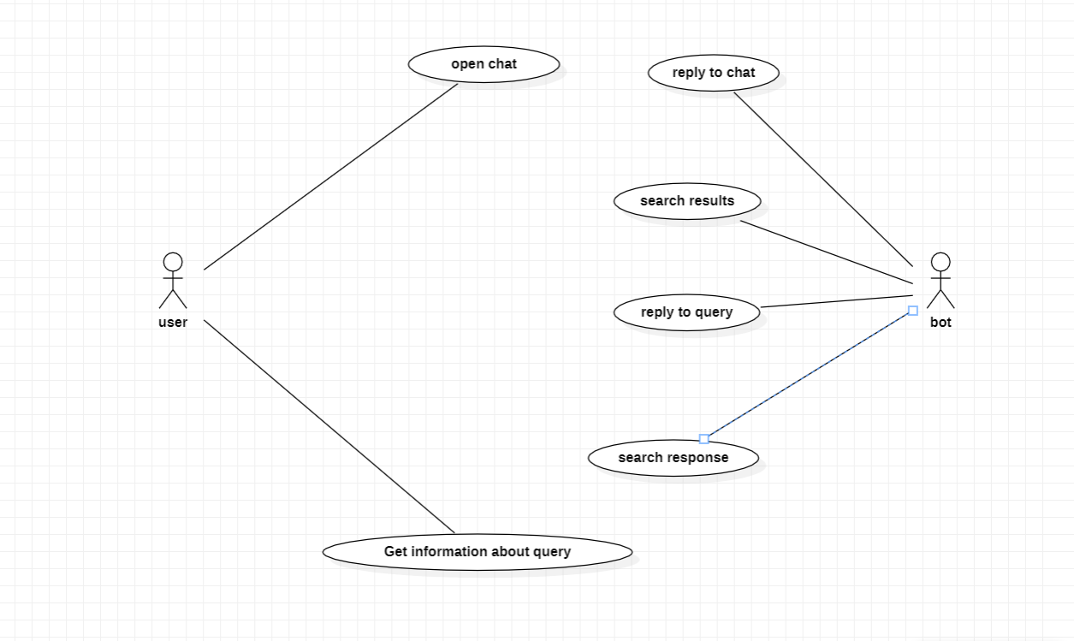
SYSTEM DESIGN:
USE CASE DIAGRAM

Slide 11
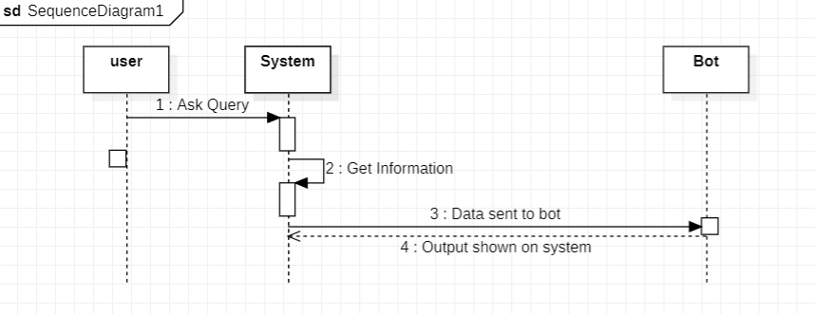
SEQUENCE DIAGRAM

Slide 12
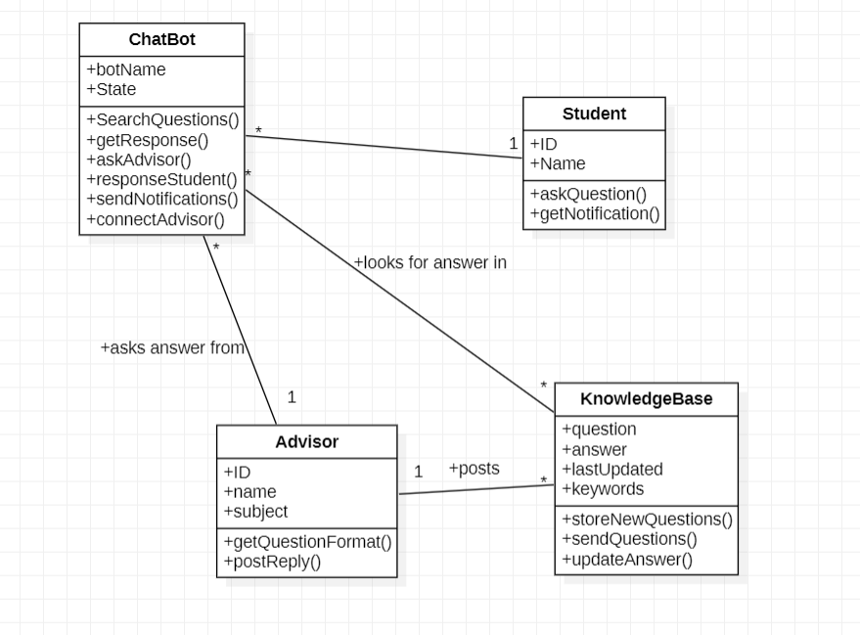
CLASS DIAGRAM

Slide 13
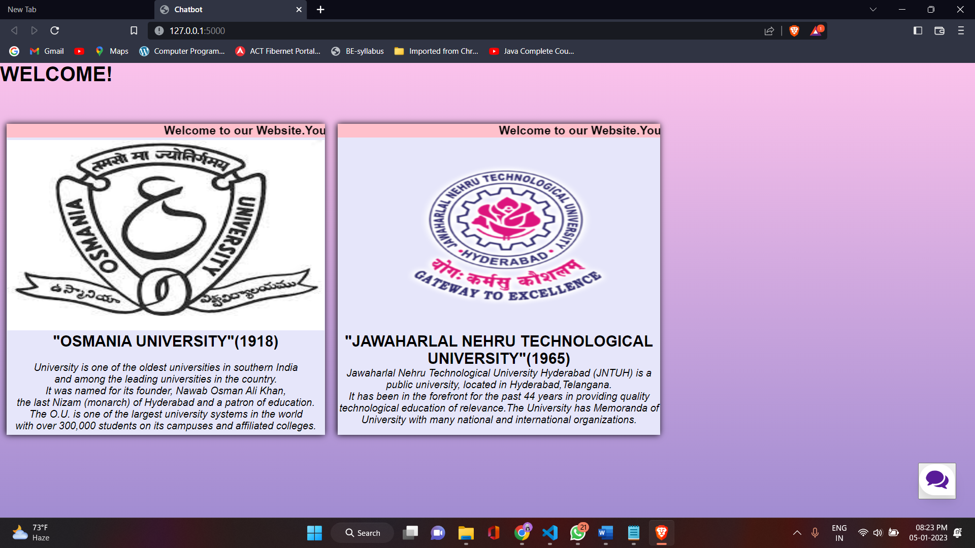
RESULTS:
WEB APPLICATION HOME PAGE

Slide 14
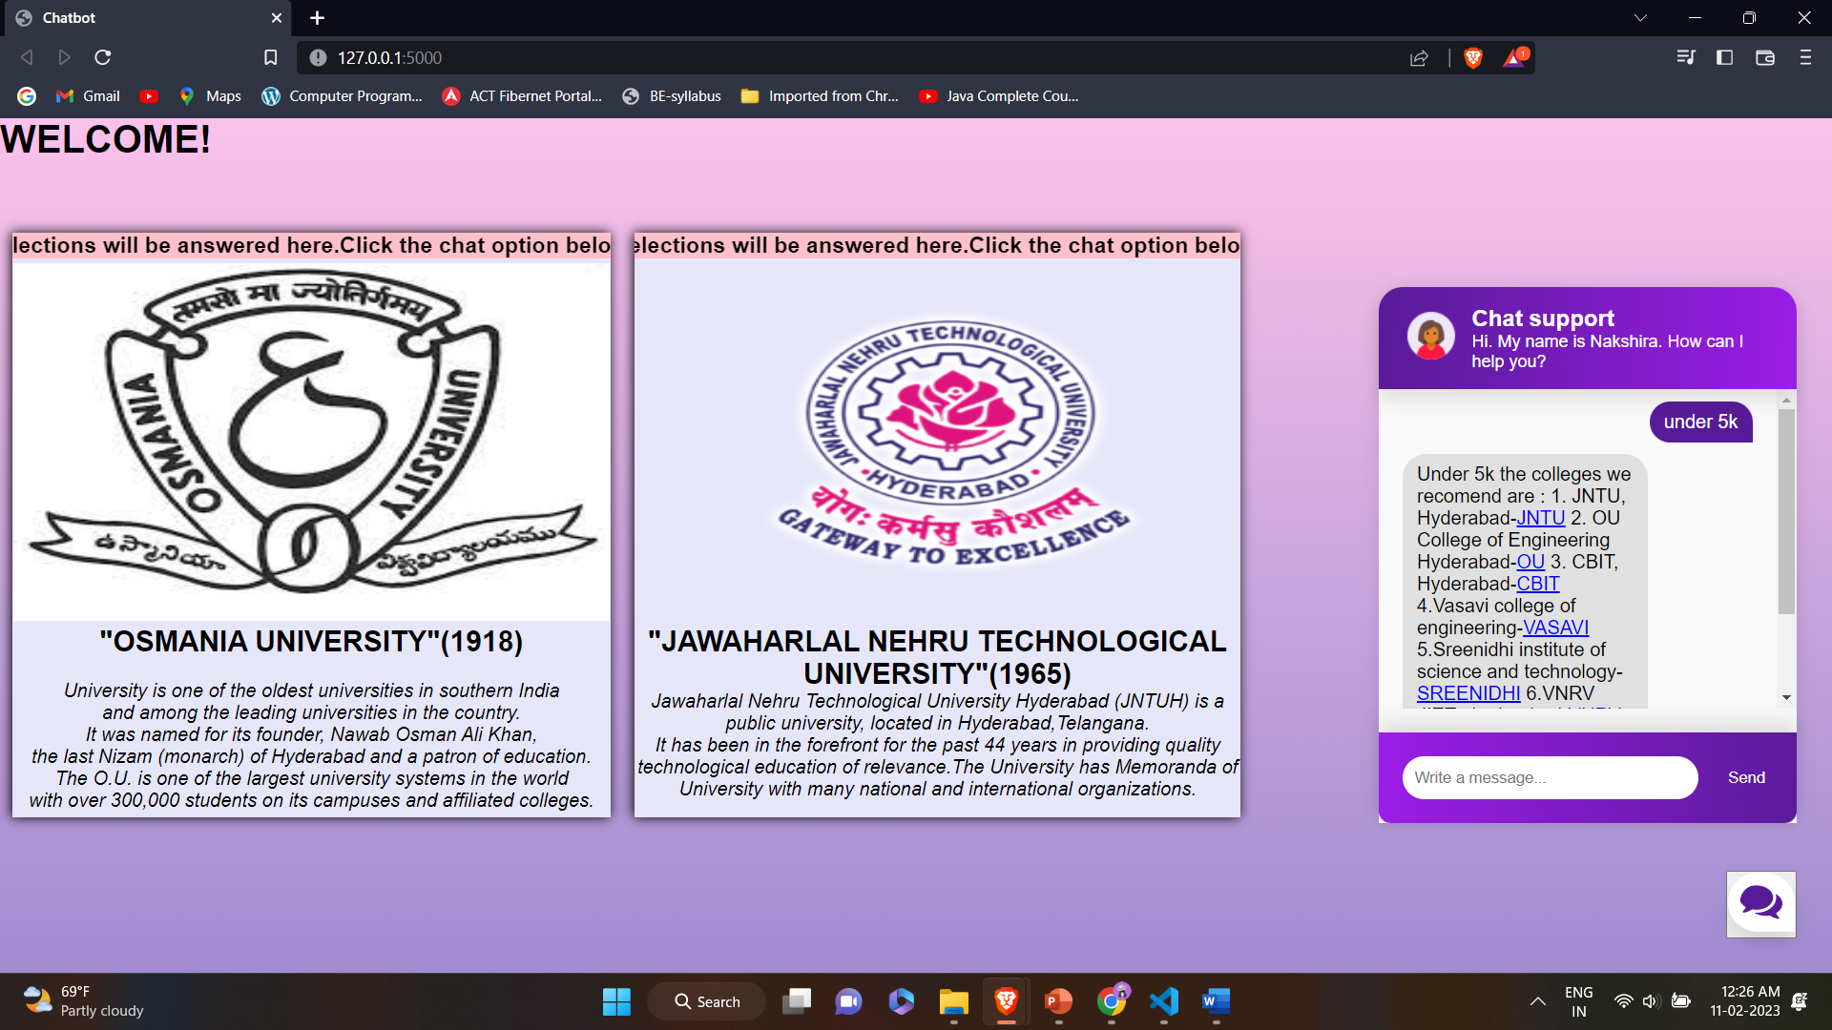
APPLICATION ON ANSWERING QUERY

Slide 15
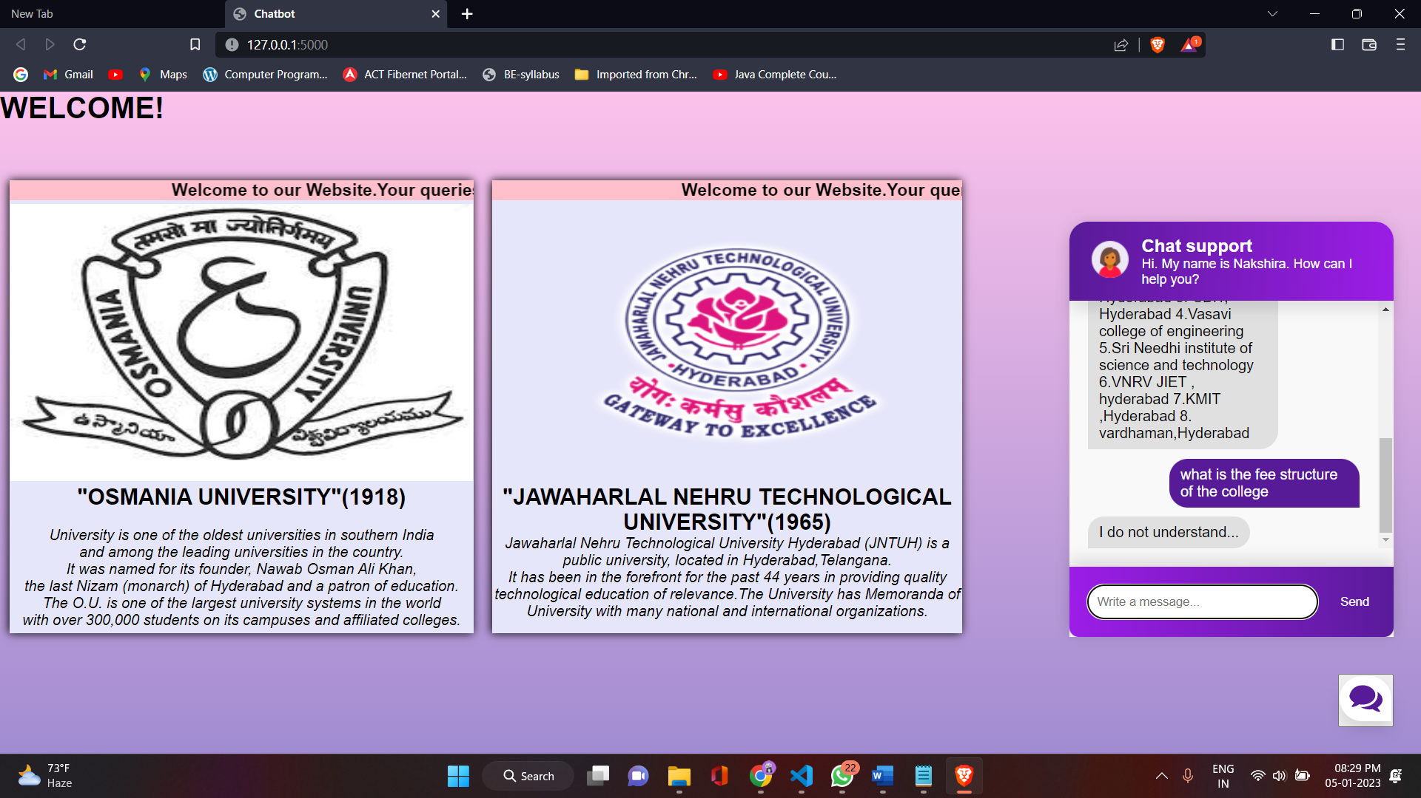
APPLICATION ON ANSWERING QUERY THAT IS NOT UNDERSTOOD BY THE SYSTEM

Slide 16
CONCLUSION AND FUTURE SCOPE:
This System is a web application that provides answers to the query of the student.
Students just have to query through the bot which is used for chatting. The System uses built-in artificial intelligence to answer the query. The answers are appropriate to what the user queries.
The enhancement of this project can be used for all fields of students when proper datafile are given.
The user does not have to personally go to the college for inquiry. The System analyzes the question and then answers to the user.

Slide 17
REFERENCES:
https://www.drift.com/learn/chatbot/ai-chatbots/
https://www.investopedia.com/terms/c/chatbot.asp
https://chatbotslife.com/a-chatbot-abstract-1cd002e7a480
https://github.com/patrickloeber/chatbot-deployment

Slide 18
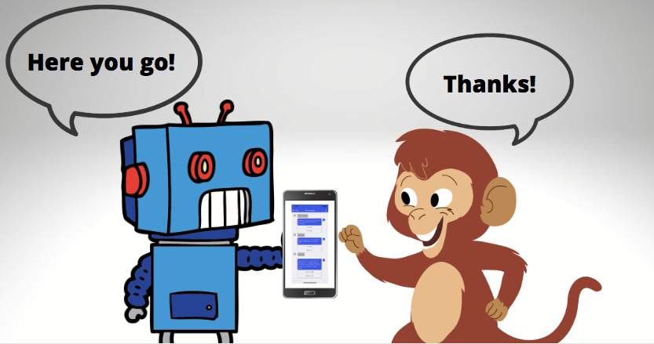
HAPPY CHATBOTING!!!

